Slide 1
Control system toolbox
linear, time-invariant (LTI) system
赵伟达

Slide 2
CONTENTS
LTI system
LTI model
LTI properties

Slide 3
LTI system
What is LTI system?
The control system toolbox mainly deals with classical control that its main feature is transfer function and modern control that its main feature is state-space. This toolbox provide a complete solution being used for modeling, analysis and design for control system, especially for LTI system.

Slide 4
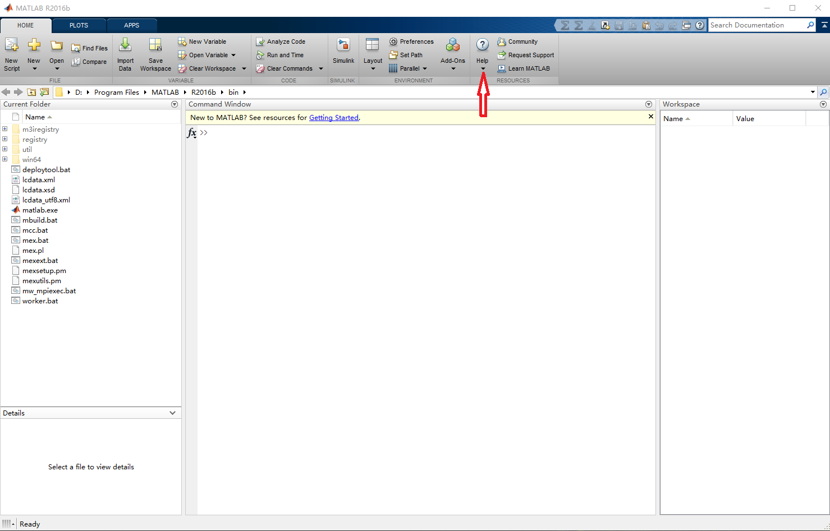
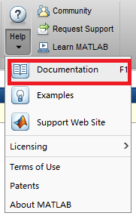
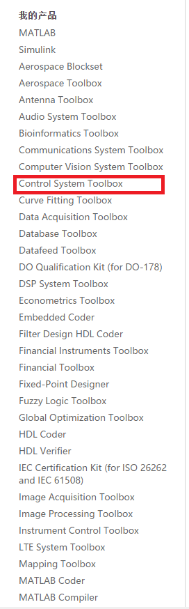
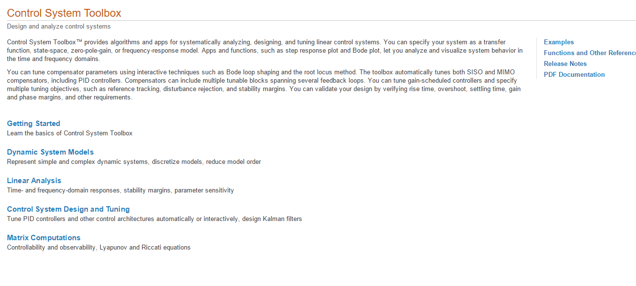

Slide 5
LTI model
Transfer functions (TF)
Zero-pole-gain (ZPK) models
State-space models (SS) of the form
Frequency response data (FRD) models

Slide 6
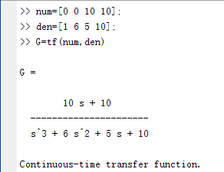
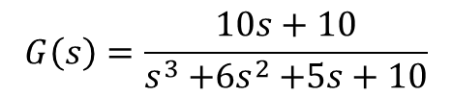
Transfer functions (TF)
$$G\left(s\right)=\frac{10s+10}{s^{3}{+6s}^{2}+5s+10}$$

Slide 7
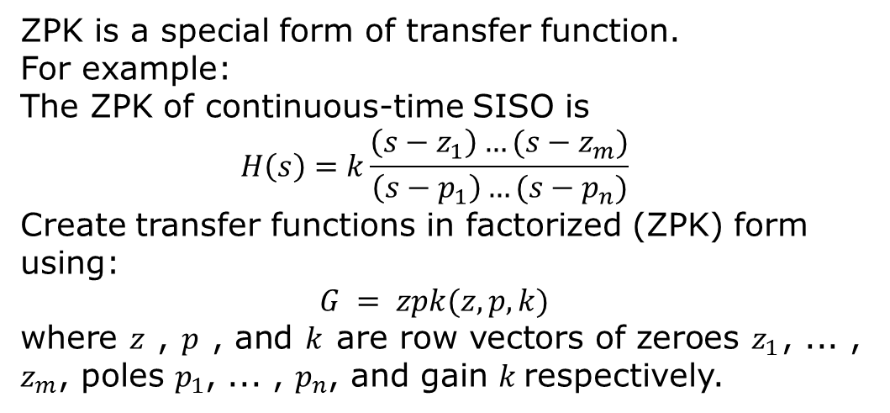
Zero-pole-gain (ZPK) models
ZPK is a special form of transfer function.
For example:
The ZPK of continuous-time SISO is
$$H\left(s\right)=k\frac{\left(s−z_{1}\right)…(s−z_{m})}{\left(s−p_{1}\right)…(s−p_{n})}$$
Create transfer functions in factorized (ZPK) form using:
$$G = zpk(z, p, k)$$
where $z$ , $p$ , and $k$ are row vectors of zeroes $z_{1}$, ... , $z_{m}$, poles $p_{1}$, ... , $p_{n}$, and gain $k$respectively.

Slide 8
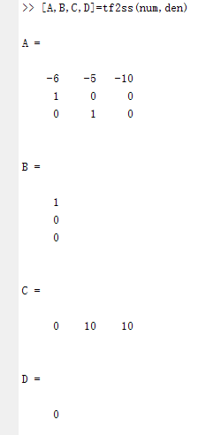
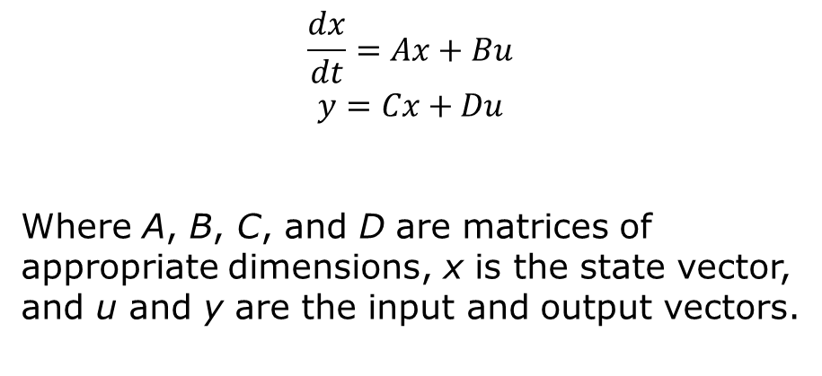
State-space models (SS) of the form
$$\frac{dx}{dt}=Ax+Bu$$
$$y=Cx+Du$$
Where A, B, C, and D are matrices of appropriate dimensions, x is the state vector, and u and y are the input and output vectors.

Slide 9
LTI properties
From a data structure standpoint, the LTI properties are the various fields in the TF, ZPK, SS, and FRD objects. These fields have names (the property)And are assigned values (the property values)Generic properties, common to all four types of LTI objects, and model-specific properties that pertain only to one particular type of model.

Slide 10
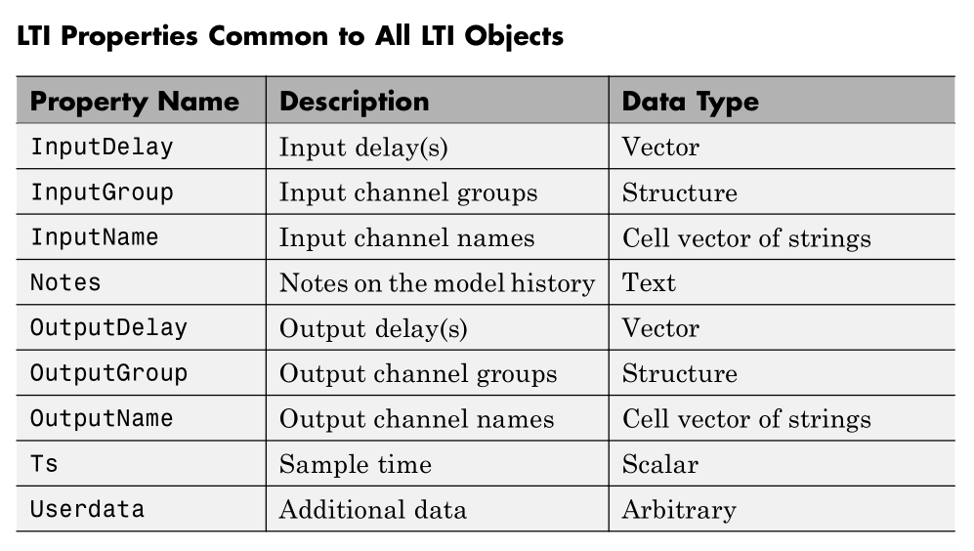

Slide 11
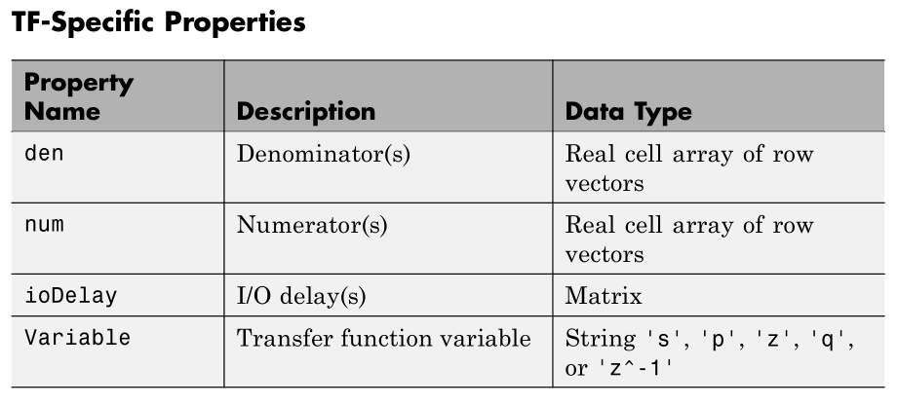

Slide 12
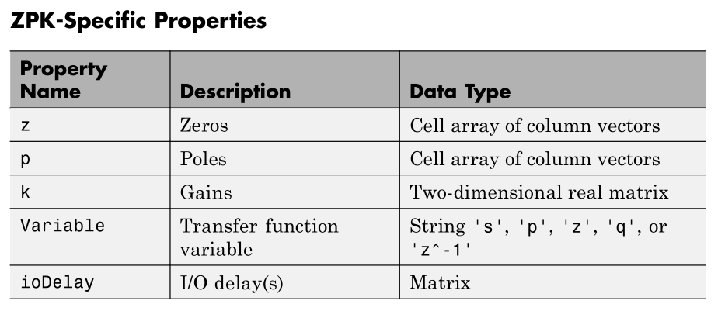

Slide 13
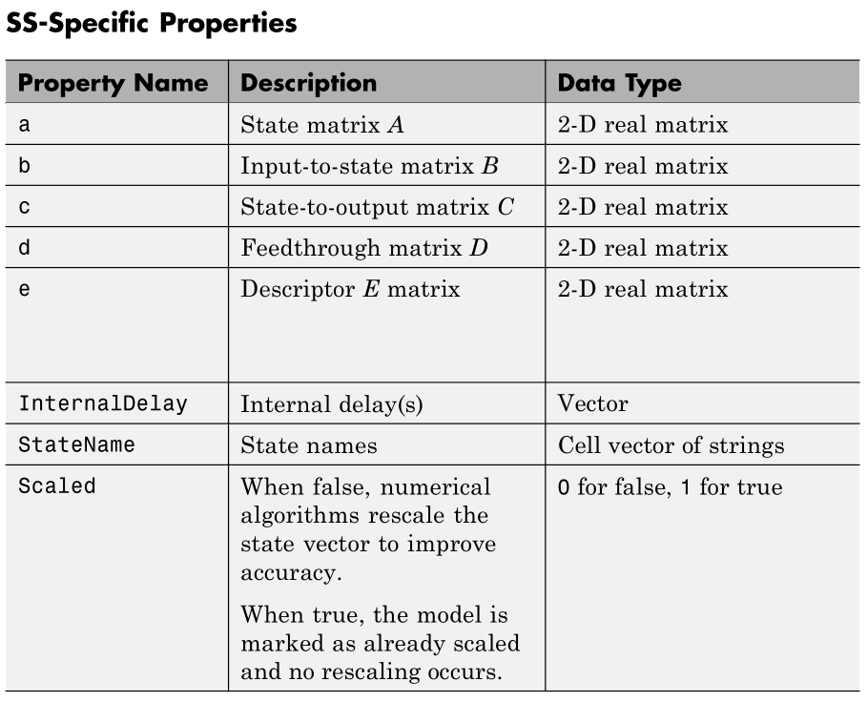

Slide 14
